Slide 1
Lecture 11: Serial Data Communication & 8251

Slide 2
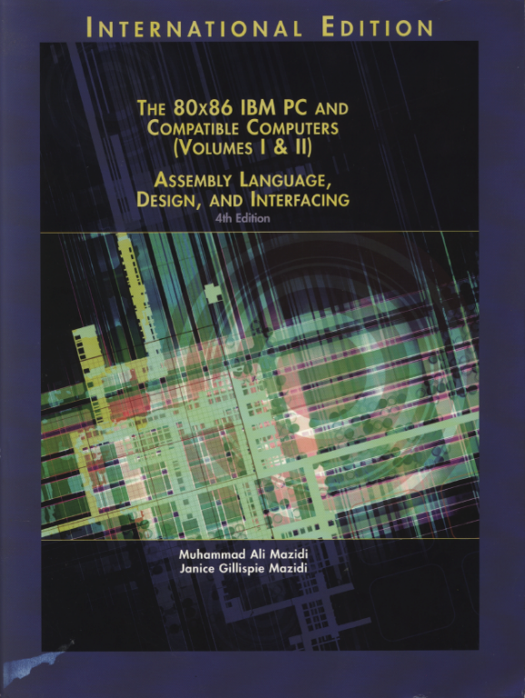
Reference Book:
The 80x86 IBM PC and Compatible Computers
Chapter 17
Serial Data Communication and the 8251 Chip

Slide 3
Data Communication
Data transmission is the transfer of data from point to point often represented as an electromagnetic signal over a physical communication channel
A communication channel refers to the medium used to convey information from a sender (or transmitter) to a receiver.
Examples: copper wires, optical fibbers or wireless communication channels.

Slide 4
Two Ways: Parallel & Serial
Parallel data transfers:
Each bit uses a separate line (wire)
Often 8 or more lines are used
Control signals in addition
Fast & expensive & for short-distance communication
Serial data transfers:
One single data line
Bits are sent over the line one by one
No dedicated lines for control signals
Cheap & slow & for long-distance communication

Slide 5
The Whole Picture of Serial Communication
The sender and receiver need a protocol to make sense of data:
e.g., how the data is packed, how many bits constitute a character, when the data begin and end
Computer
Computer
Serial
interface
MODEM
channel
MODEM
Serial
interface
DTE
DCE
DCE
DTE
DTE- Data Terminal Equipment, usually a computer.
DCE- Data Communication Equipment, usually a modem.
Serial interface –ICs such as 8251A,16550, and 8250, connecting DTE and DCE.

Slide 6
Serial Communication
Data transfer rate
Synchronization methods
Communication modes
Error detection
Modulation and Demodulation

Slide 7
Data Transfer Rate
Symbol rate, a misnomer is baud rate
The number of distinct symbol or pulse changes (signaling events) made to the transmission medium per second in a digitally modulated signal or a line code, quantified using the baud unit
Each symbol can represent one (binary encoded signal) or several bits of data
Bit rate
the number of bits that are conveyed or processed per unit of time, quantified using the bits per second (bit/s or bps) unit

Slide 8
Synchronization Methods
Asynchronous serial communication:
Transfer one byte at a time
The starting of each byte is asynchronous, and therefore each byte needs synchronization between the sender and the receiver using start bit.
Synchronous serial communication:
Transfer a block of data at a time
The sender and the receiver are synchronized at the beginning of data transfer using synch characters.
Notes:
What does synchronization mean?

Slide 9
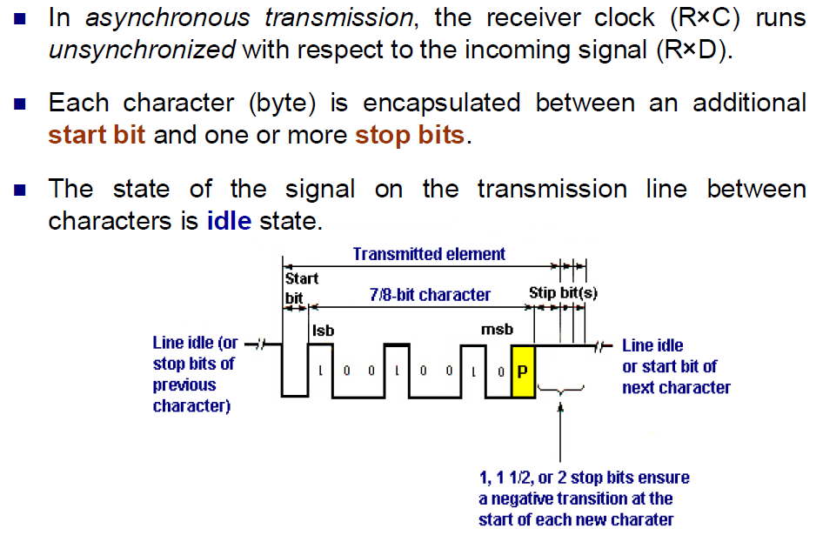
Asynchronous Transmission

Slide 10
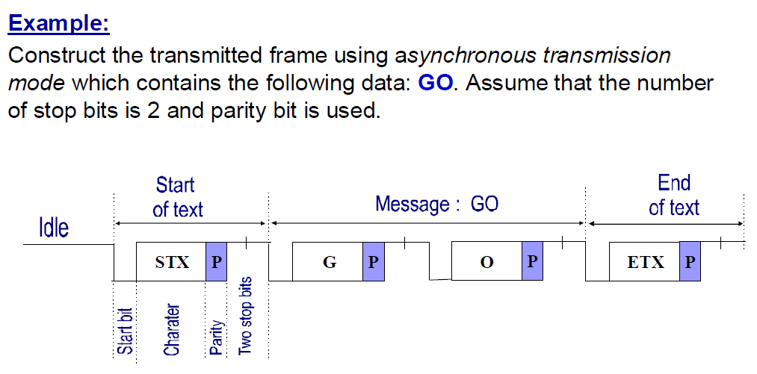
Asynchronous Transmission

Slide 11
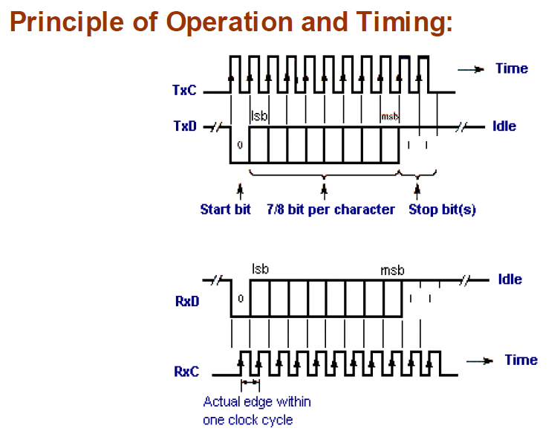

Asynchronous Transmission
Notes:
What is the problem of asynchronous transmission in practice?

Slide 12
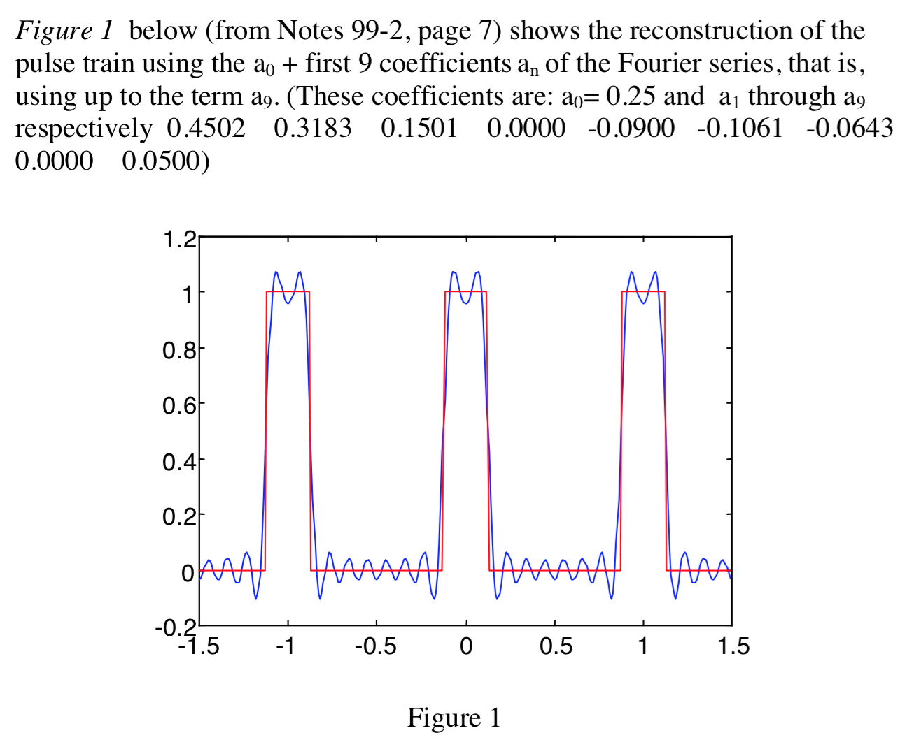
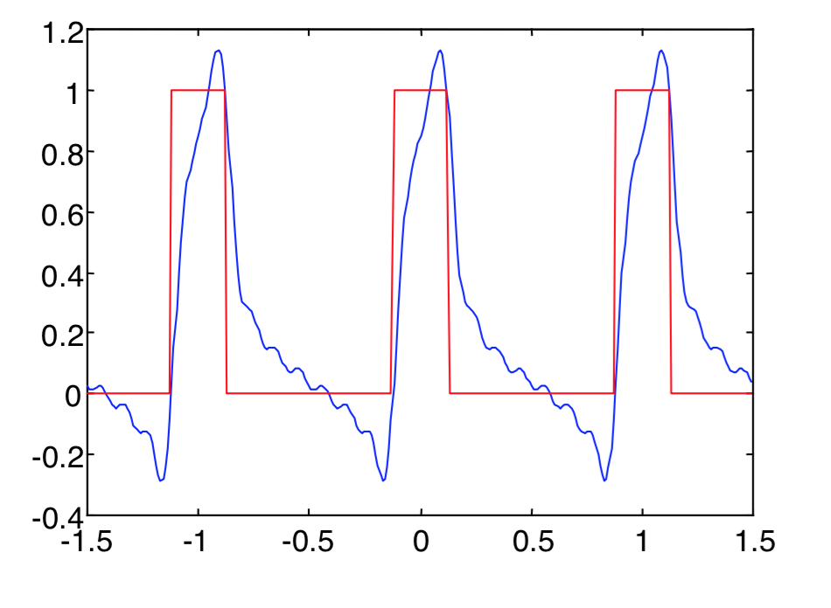
Amplitude/Phase Distortions

Slide 13
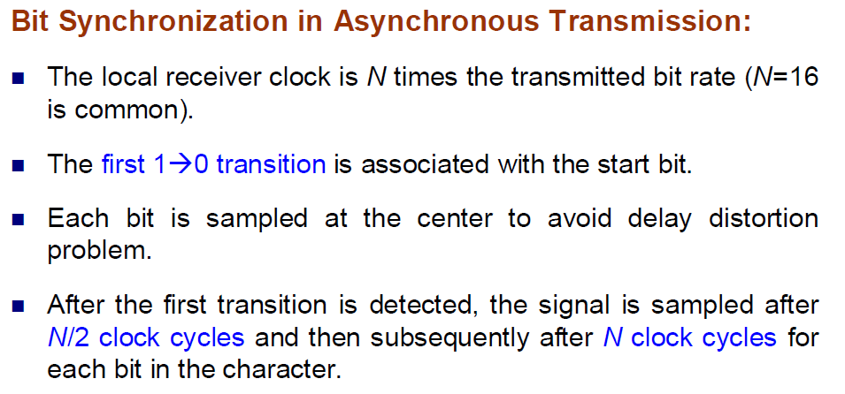
Asynchronous Transmission

Slide 14
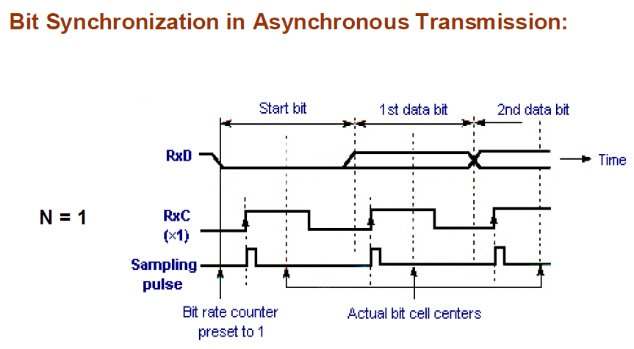
Asynchronous Transmission

Slide 15
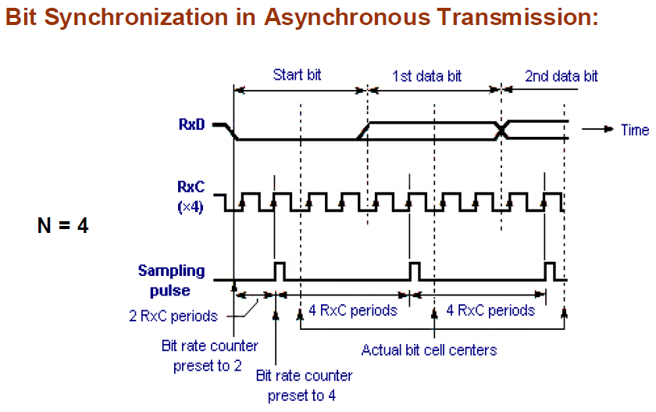
Asynchronous Transmission

Slide 16
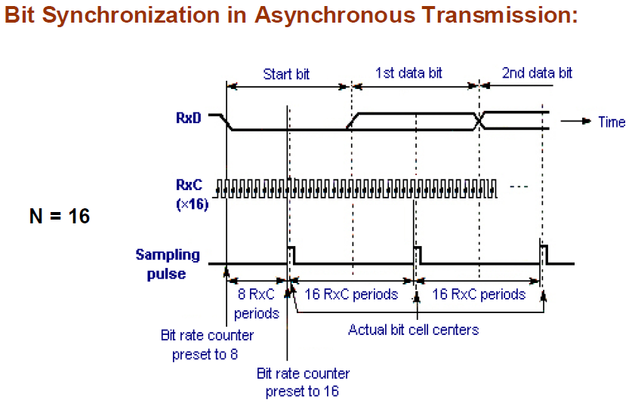
Asynchronous Transmission

Slide 17
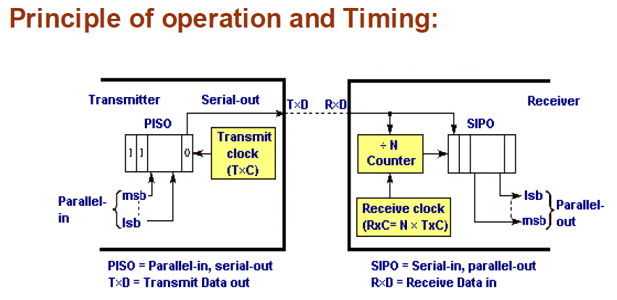
Asynchronous Transmission

Slide 18
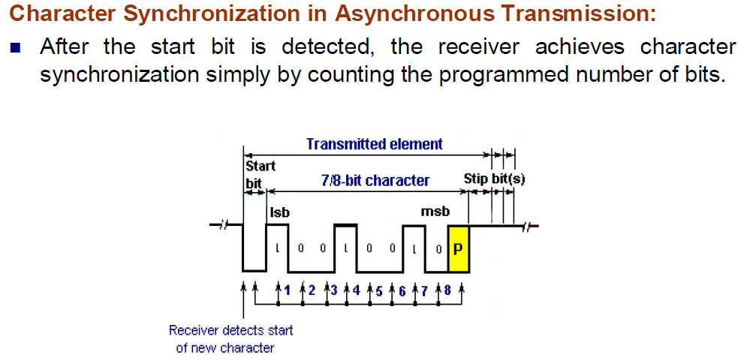
Asynchronous Transmission

Slide 19
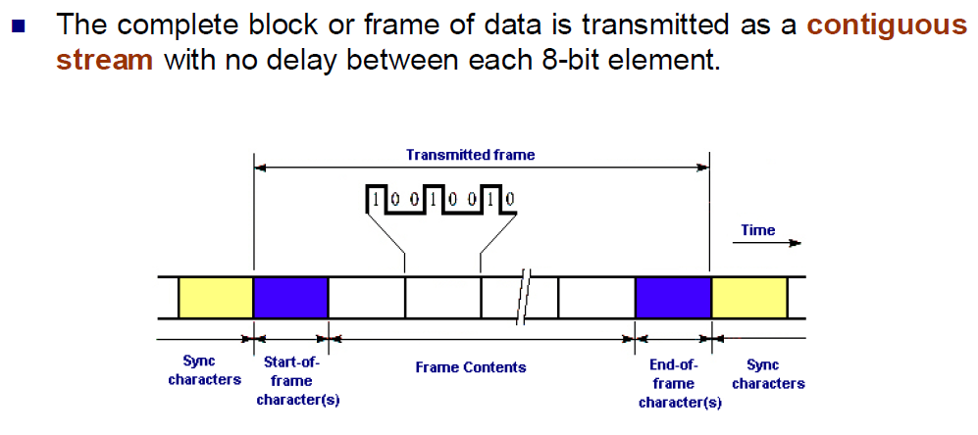
Synchronous Transmission

Slide 20
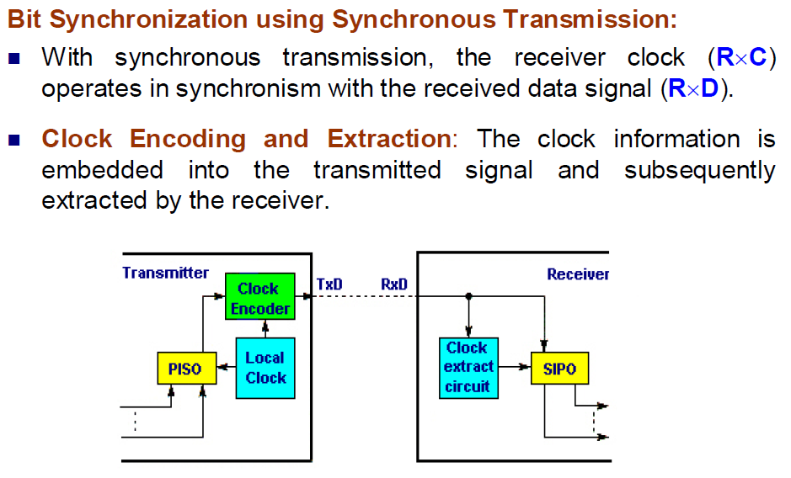
Synchronous Transmission

Slide 21
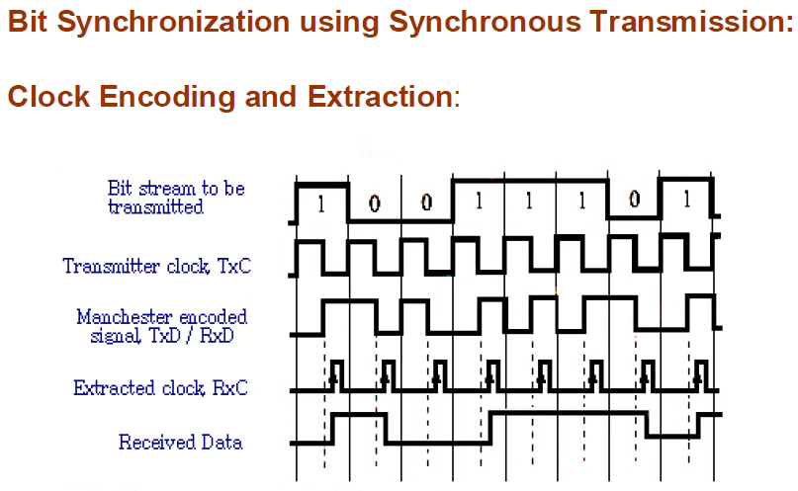
Synchronous Transmission

Slide 22
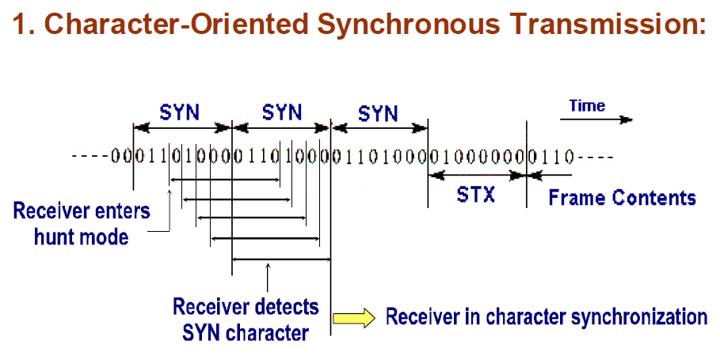
Synchronous Transmission

Slide 23
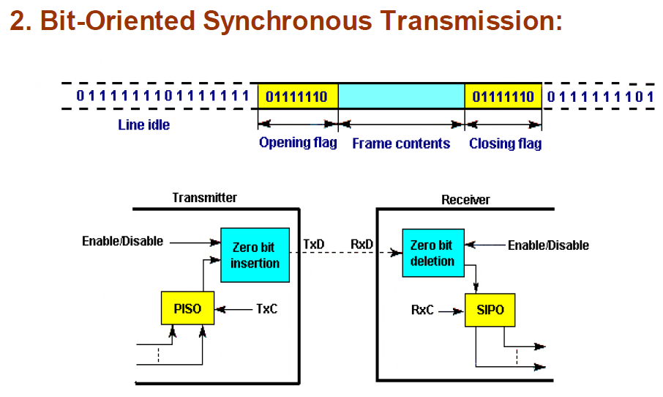
Synchronous Transmission
Bit stuffing (or zero bit insertion): inserts a “0” after five consecutive 1s
Bit stuffing (or zero bit insertion): inserts a “0” after five consecutive 1s

Slide 24
Communication Modes
Simplex:
Only one way
E.g., printer
Half-duplex:
Data is transmitted one way at a time
E.g., walky-talky
Full-duplex
Data can go both ways at the same time
E.g., telephone

Slide 25

Error Detection
Parity bit
Used in asynchronous serial communication
Put an extra parity bit at the end of each character
Even-parity: the data and the parity bit has an even number of 1s; odd-parity
CRC Calculation
k-bit data, n-bit CRC:
Example:
Given G(x)= x³ + x² + 1 ->1101, (take the coefficients of the polynomial, n=3)
If data is 1010110, M(x) * X^{n} -> 1010110000
CRC = 1010110000%1101 (the remainder of binary division, using XOR operation)

Slide 26
Modulation and Demodulation
It is not suitable to transmit digital signals directly on a channel for a long distance
signal distortion
Need to modulate digital signals and get analog signals at the sender, and demodulate the analog signals and get the original digital signals
Three parameters (Amplitude, frequency, phase) of the carrier can be used for the modulation and demodulation purpose
Amplitude-Modulating (AM)
Frequency-Shift Keying (FSK)
Phase-Shift Keying (PSK)

Slide 27
Modulation and Demodulation
1 and 0 are represented using different amplitude
1 and 0 are represented using different frequency

Slide 28
8251 USART Chip
Capable of doing both asynchronous and synchronous data communication
synchronous: baud rate 0-64K, characters can be 5, 6, 7, or 8 bits, automatically detect or insert sync characters
Asynchronous: baud rate 0-19.2K, characters can be 5, 6, 7, or 8 bits, automatically insert start, stop and parity bits, TxC and RxC clocks can be 1, 16, or 64 times of the baud rate
Full duplex, double-buffered
Error checking circuit

Slide 29
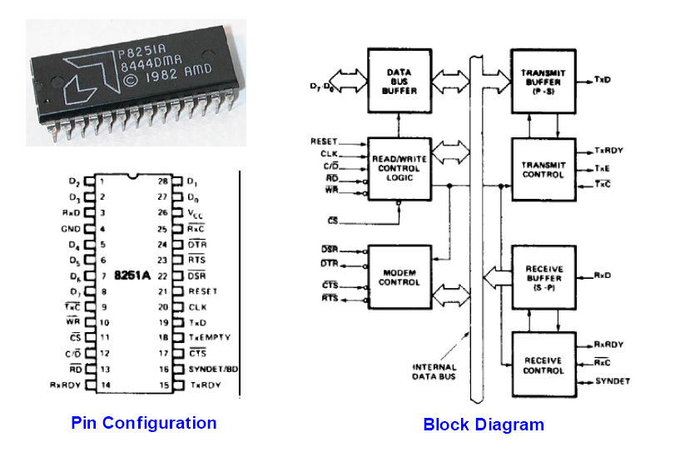
8251

Slide 30
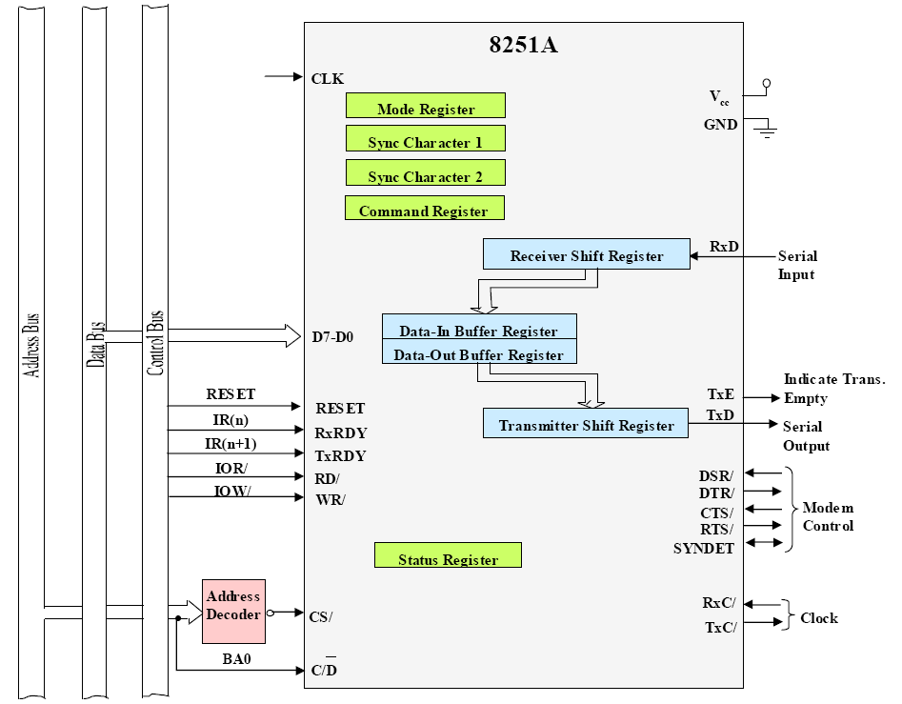
8251 Communication Interface
write to the control port
read from the data port
write to the data port
read from the control port

Slide 31
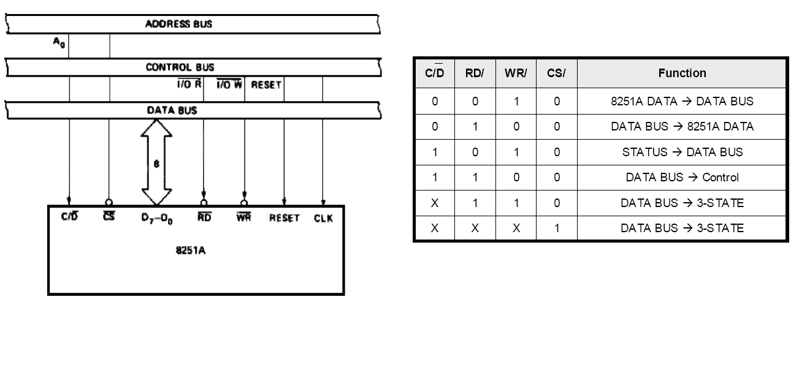
Interfacing to 8088

Slide 32
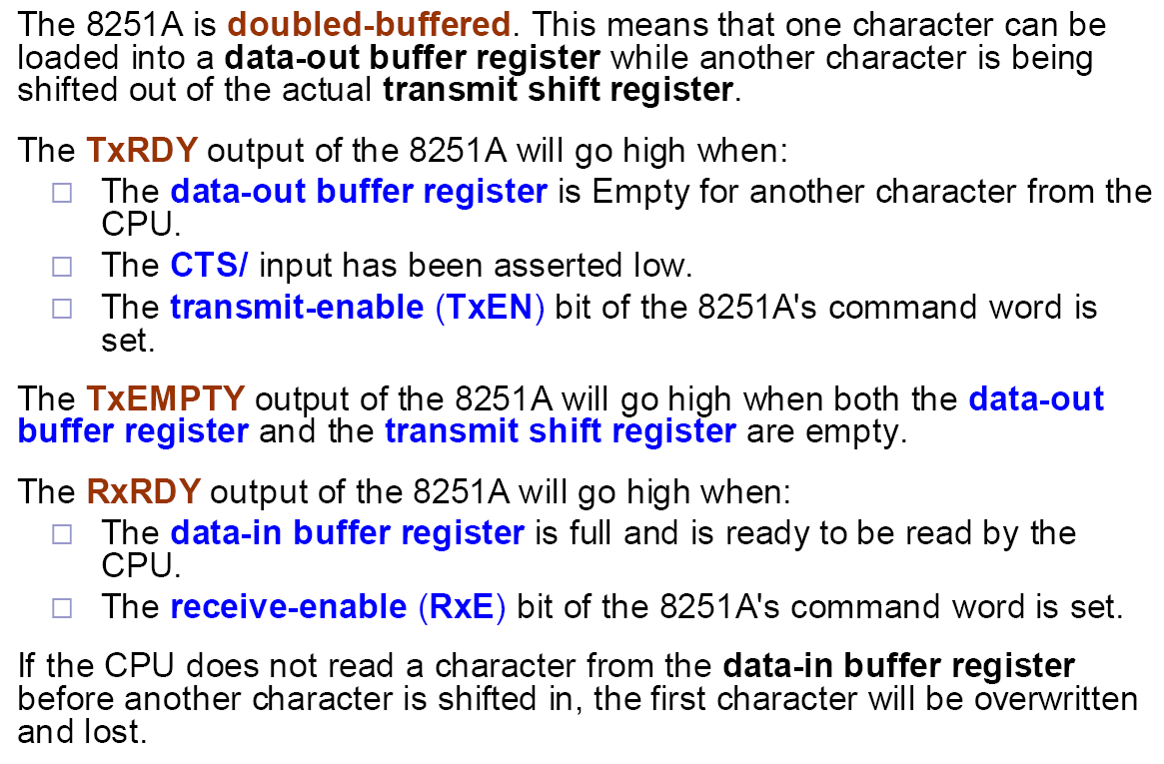
8251 Signals

Slide 33
8251 Mode Word
Asynchronous
Synchronous

Slide 34
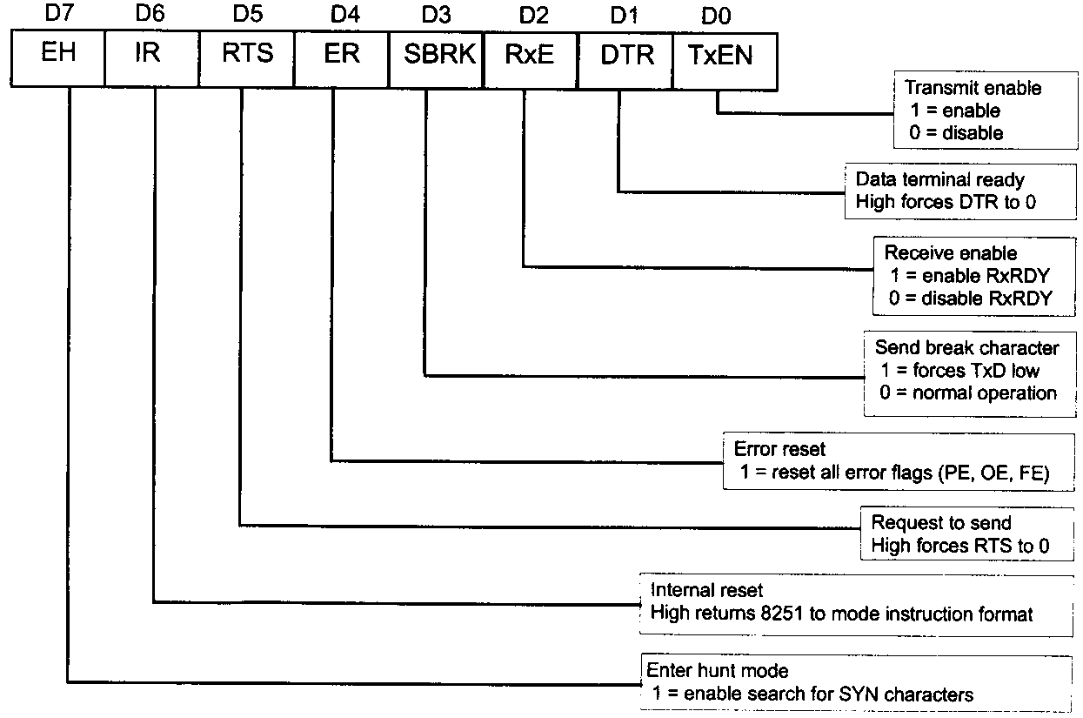
8251 Command Word

Slide 35
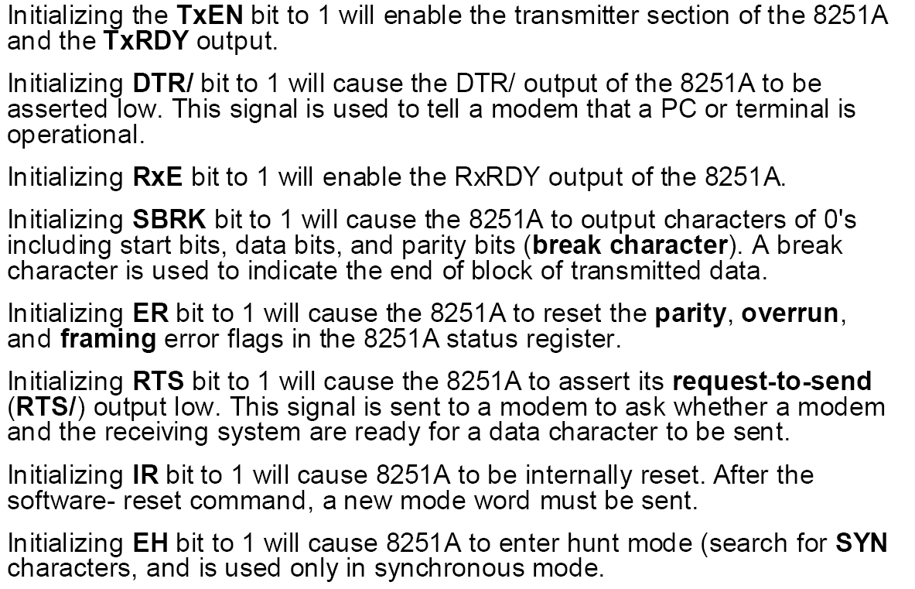
8251 Command Word

Slide 36
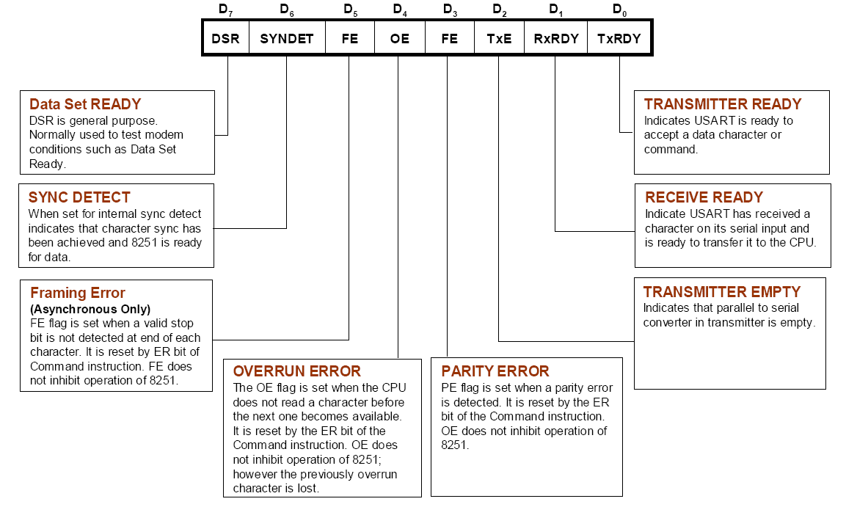
8251 Status Word

Slide 37
Operation of 8251A

Slide 38
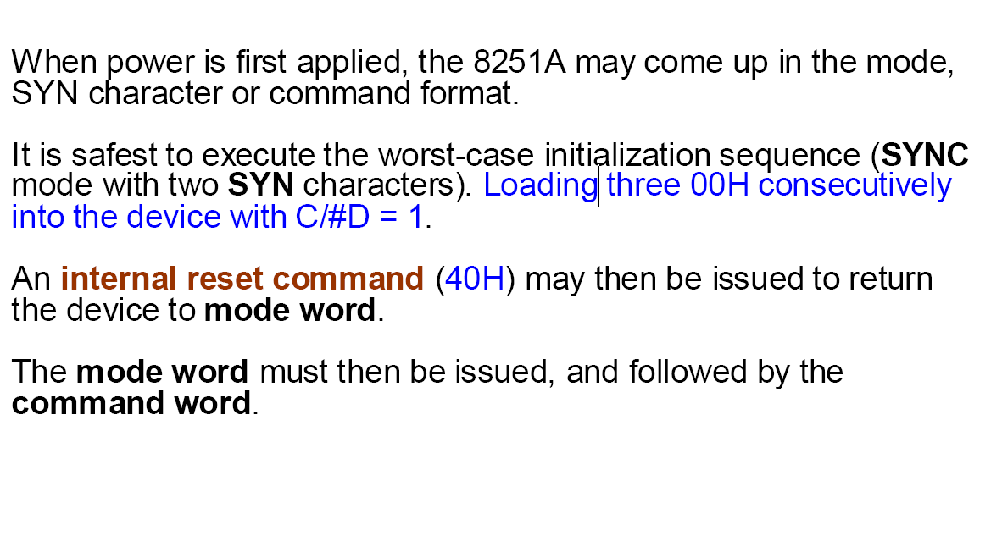
8251A Internal Reset on Power-Up

Slide 39
8251 Programming Example
Use 8251 to transfer 256 characters in asynchronous mode, assuming that the port addresses are 208H and 209H, the baud factor is 16, and 1 stop bit, 1 start bit, no parity bit, and 8-bit character are used.
Solution: Sender side: data is stored in Buf1
LEA DI, Buf1
MOV DX,209H
MOV AL,00H ;worse-case init.
OUT DX，AL
CALL DELAY
MOV AL,00H ;
OUT DX，AL
CALL DELAY
MOV AL,00H ;
OUT DX，AL
CALL DELAY
MOV AL,40H ;reset command
OUT DX，AL
MOV AL，01001110B ; mode word
OUT DX，AL
MOV AL，00110111B ; command word
OUT DX，AL
MOV CX，256 ; to send 256 char.
NEXT： MOV DX, 209H
IN AL，DX ; status word
AND AL，01H ; TxRDY?
JZ NEXT
MOV AL，[DI]
MOV DX，208H ; data register 208H
OUT DX，AL ; send the char.
INC DI
LOOP NEXT

Slide 40
8251 Programming Example
Receiver side: data will be stored in Buf2
Data segment
buf2 DB 256 dup(?)
Data ends
┆
MOV DX,209H
MOV AL,00H
OUT DX，AL
CALL DELAY
MOV AL,00H
OUT DX，AL
CALL DELAY
MOV AL,00H
OUT DX，AL
CALL DELAY
MOV AL,40H ; reset
OUT DX，AL
MOV AL，01001110B ; mode word
OUT DX，AL
MOV AL，00110111B ; command word
OUT DX，AL
MOV CX，256 ; to receive 256 char.
MOV SI，0
NEXT: MOV DX，209H
IN AL，DX ; status word
AND AL，02H ; RxRDY？
JZ NEXT
MOV DX，208H
IN AL，DX ; receive a char
MOV buf2[SI]，AL
INC SI
LOOP NEXT

